Slide 1
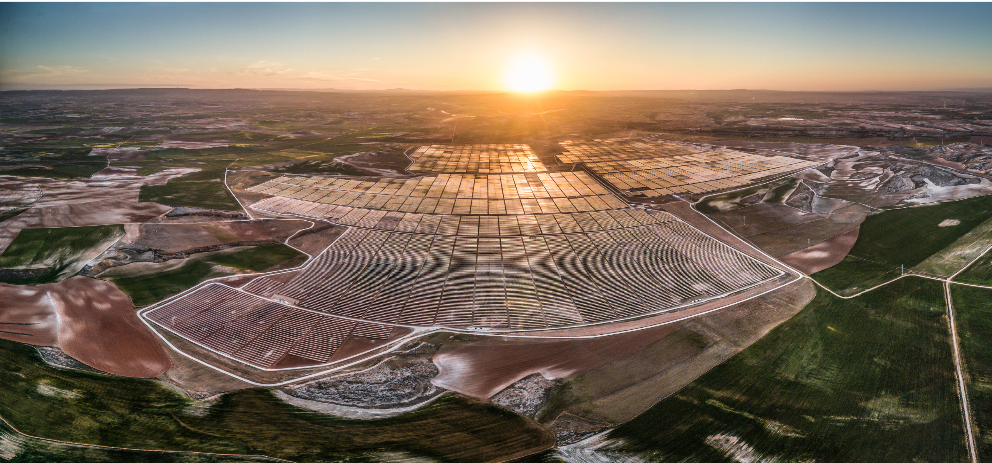

Chisme Solar and Storage – Mills County Visit

Slide 2
Our Team
Mike Luo
Siyuan Xin
Nathan Stumpff
General Manager
Director of Project Development
Development and Asset Manager
General Manager for CNE's US business since 2011. Overseeing development and scaling of the RRCE platform along with capital raising and deployment
Siyuan has over 13 years of experience in the Energy Industry and a doctoral degree from UC Berkeley focusing on energy storage. Had successful career at Tesla Motors as a Powertrain and battery engineer, co-founded Quantum Storage, and worked at Google X incubating utility scale energy storage technology.
Solar and energy storage professional with 16 years of experience covering design, installation, project management, operations and maintenance of solar and battery energy systems across North America and in every market segment
Mike Luo
Donald Battenfelder
Maria Aparecida de Amorim
Samuel Tesfaye
Project Manager
Senior Development Engineer
Director Of Project Finance
Experience consists of 45 years managing medium to large scale businesses and projects in North America, South America, Europe and Asia. Responsibilities included design & engineering, procurement & manufacturing, operations, regulatory, and financial tracking
Senior Power Systems Engineer with over 30+ years of experience with generation and transmission studies. At CNE, she leads the interconnection process of utility-scale PV and BESS projects. Prior to joining CNE, Maria worked at Wunderlich-Malec and Siemens-PTI
Investment and Project Finance professional, with over 14 years of experience in renewable energy, conventional power generation and commodity trading. Prior to joining CNE, Samuel had successful careers at Bp, Austin Energy and Goldman Sachs

Slide 3
About Us
4.02GW
ERCOT Pipeline
1.0 GW
COD by 2027
$1.04B
CAPEX by 2027
4.05GW
Operated by Group
Red River Clean Energy is a subsidiary of CNE group, a multi-national renewable energy developer with over 4GW of operating assets internationally. Red River is engaged in the development and operation of renewable projects in the United States, with a focus on the growing ERCOT market.
Confidential

Slide 4
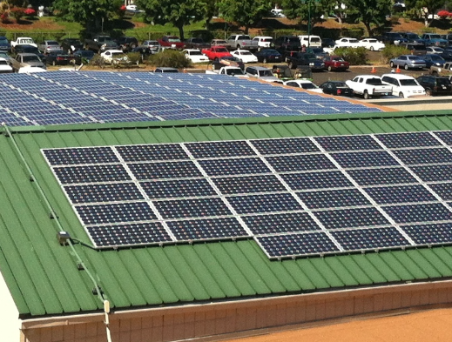
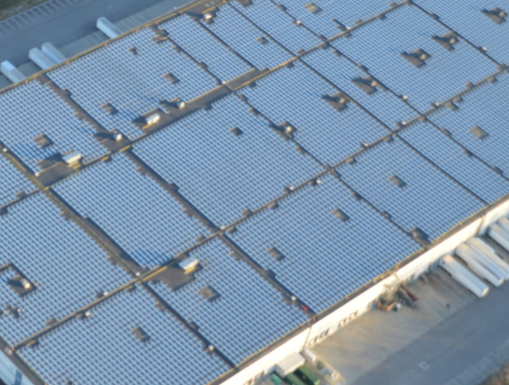
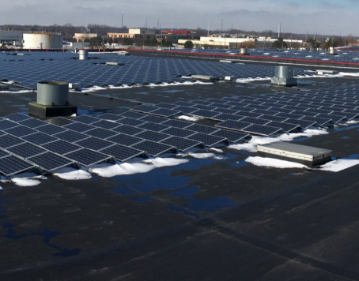
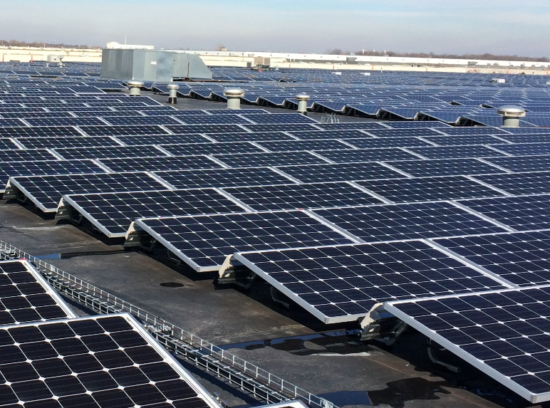
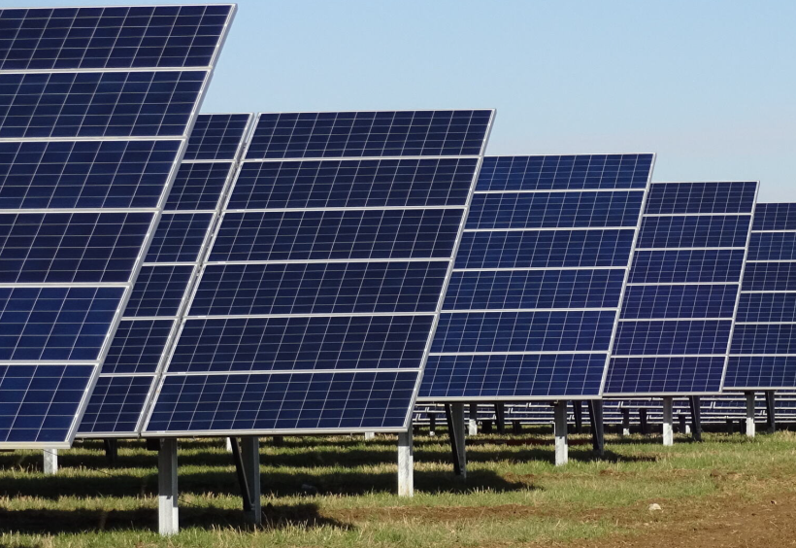
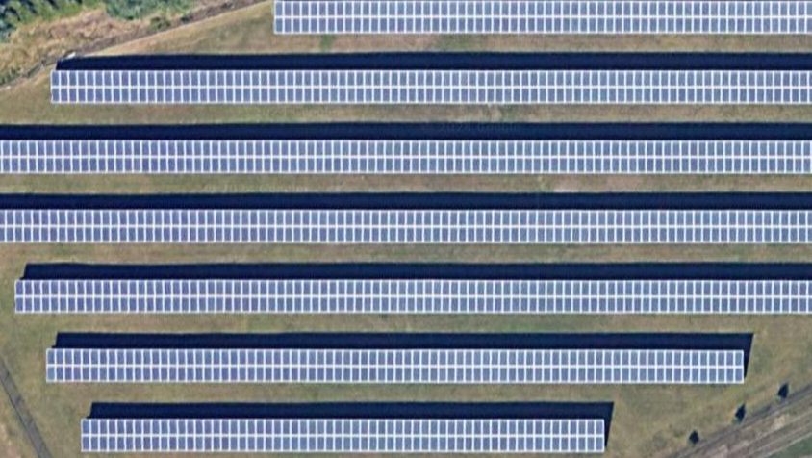
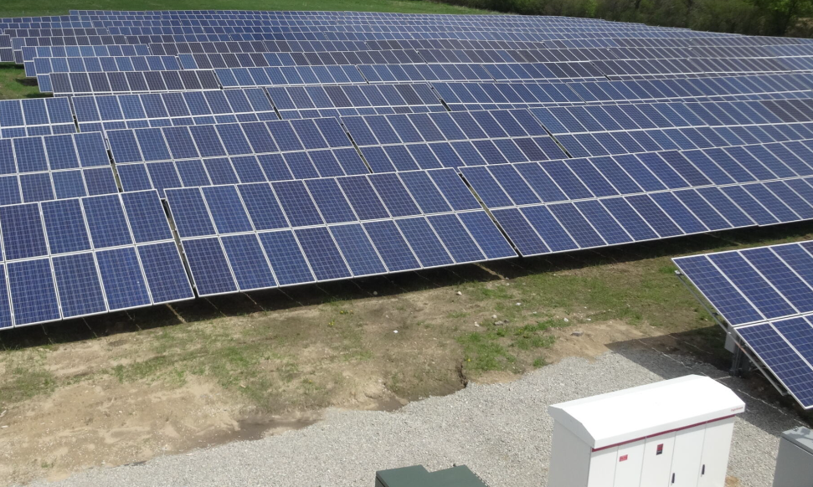
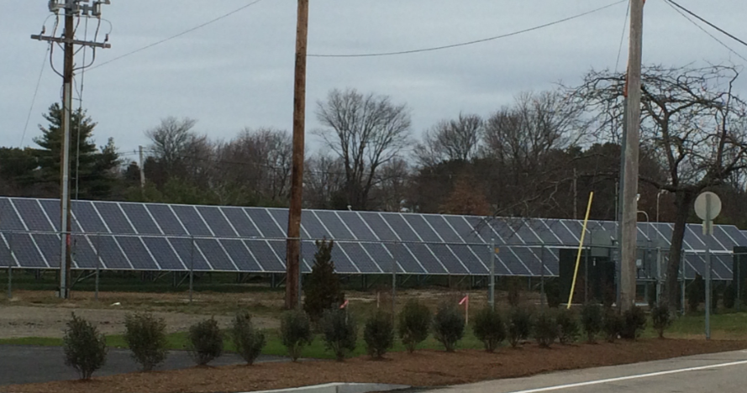
Owned US Operating Assets
Hoku Portfolio
HMV Indy – Building 98
HMV Indy – Building 87
HMV Indy – Building 129
HMV Indy – Building 98
Hawaii
905.63 KW
Indianapolis, IN
3,979.36 KW
Indianapolis, IN
2,910.38 KW
Indianapolis, IN
2,910.38 KW
Minster PV
Johnston PV
Jefferson Solar
North Kingstown Solar
Minster, OH
4,309.2 KW
Johnston, RI
1,495.11 KW
Jefferson, WI
1,077.84 KW
North Kingstown, RI
494 KW

Slide 5
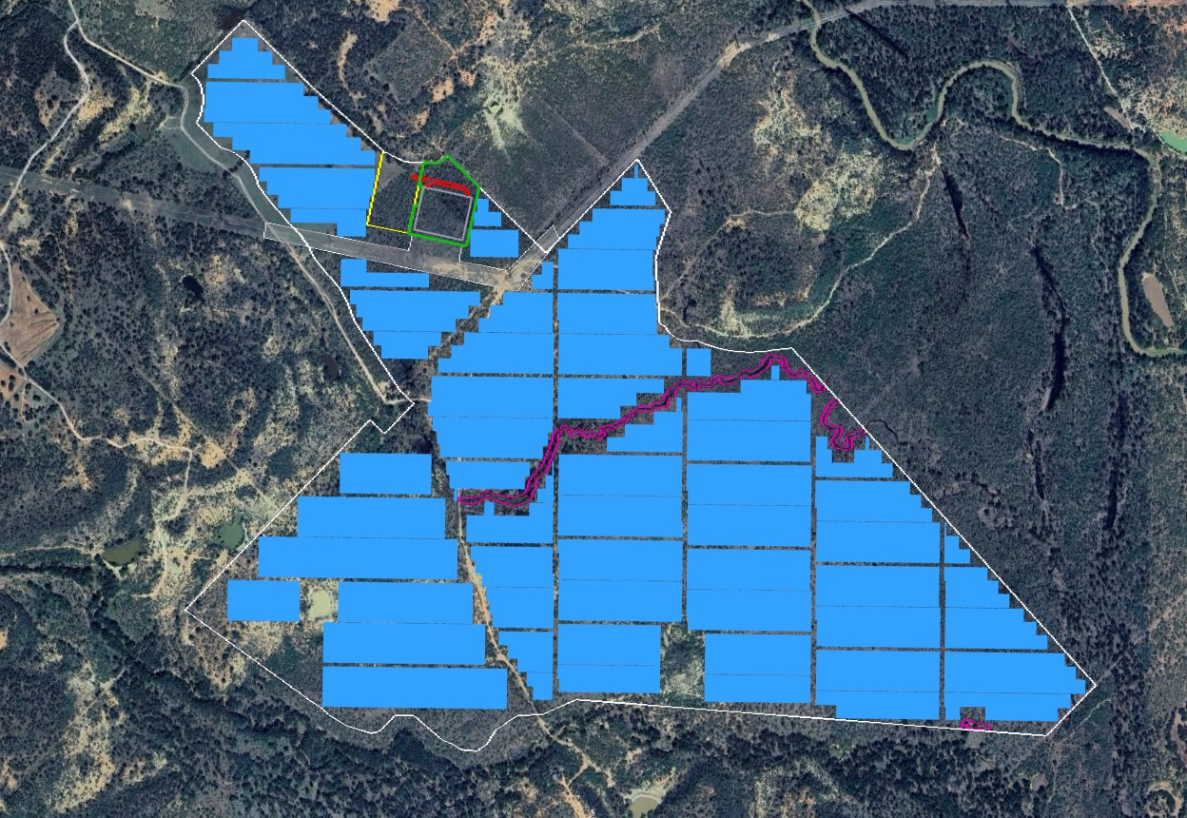
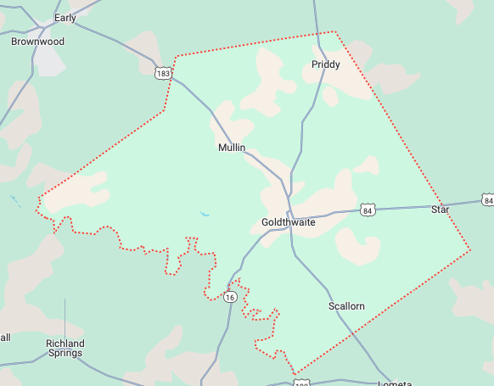
Project Details
Chisme Solar and Storage
Substation Location
Location
PV Specs
BESS Specs
BESS Location
31.583027°
-98.839109°
207 MWdc
147 MWac
146 MWac (2hr)
300 MWh
345 kV Transmission Line
Land
System Topology
Site Access Road and New Gate
~720 Acres
Single Axis Tracker
Tapping Existing 345KV line
AC-coupled BESS
IA submittal/Study Kickoff
PPA Execution
COD
Sept 2022 | Oct 2024 | Jul 2025 | Nov 2025 | Apr 2027
SGIA execution/Security
NTP/FC

Slide 6
Job Creation
Chisme Solar and Storage project is anticipated to bring approximately 250 jobs to Mills County during the construction period
Power Generation
Project will generate about 384000 MWh of energy that can support local and state level growth.
Tax
The project would significantly contribute to the economic development of Mills County. With a potential $265 million investment, the project would be expected to generate $9.3 million in county property taxes and over $16.5 million in school taxes for Mullin ISD over a 20-year period.
UXO Land Usage
Chisme Solar will help remediate the project land, clearing former Camp Bowie UXOs buried in the ground and ensuring the land is safer for future use.
Chisme Solar and Storage
Community Plan

Slide 7
Thank You!
Contact:
Ashley Walser
ashrock4420@gmail.com

